Slide 1

Econometrics 2: Regression models for binary outcomes
Hadi Movaghari
2022-2023

Slide 2
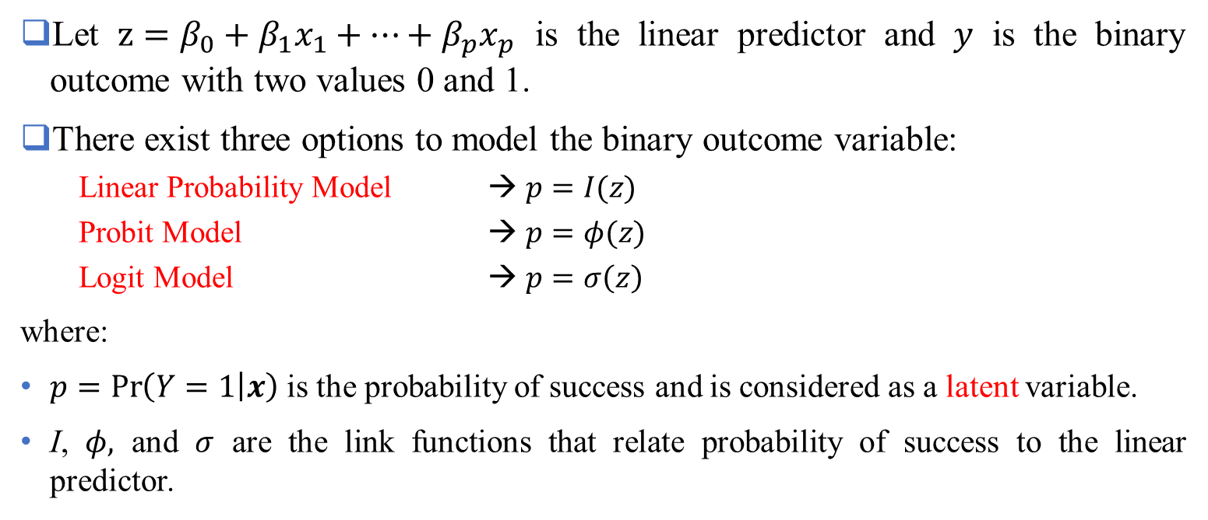
Three options
Let $z=β_{0}+β_{1}x_{1}+…+β_{p}x_{p}$ is the linear predictor and $y$ is the binary outcome with two values 0 and 1.
There exist three options to model the binary outcome variable:
Linear Probability Model → $p=I(z)$
Probit Model → $p=φ(z)$
Logit Model → $p=σ\left(z\right)$
where:
$p=\operatorname{Pr}\left(Y=1 | x\right)$ is the probability of success and is considered as a latent variable.
I, $φ,$ and $σ$ are the link functions that relate probability of success to the linear predictor.
Econometrics 2: Regression models for binary outcomes
University of Glasgow
2022-2023

Slide 3
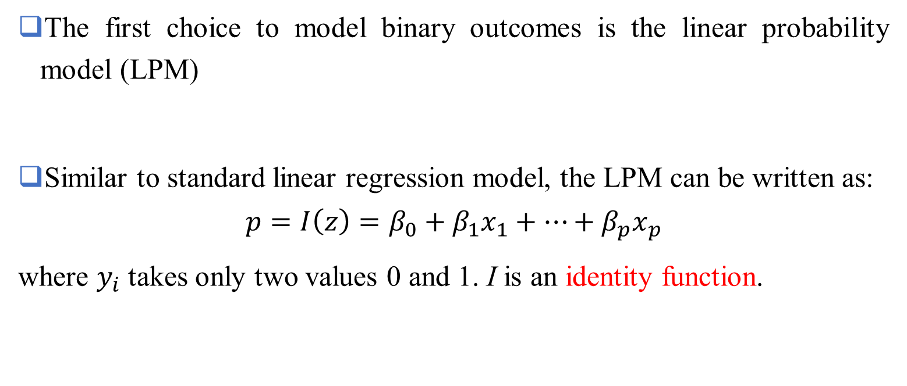
Linear Probability Model (LPM)
The first choice to model binary outcomes is the linear probability model (LPM)
Similar to standard linear regression model, the LPM can be written as:
$$p=I\left(z\right)=β_{0}+β_{1}x_{1}+…+β_{p}x_{p}$$
where $y_{i}$ takes only two values 0 and 1. I is an identity function.
Econometrics 2: Regression models for binary outcomes
University of Glasgow
2022-2023

Slide 4
Linear Probability Model (LPM) – (Cont’d)
Issues with LPM
There is no grantee to generate predicted values between to 0 and 1.
Estimates from LPM are biased and inconsistent (Horrace and Oaxaca, 2006).
Econometrics 2: Regression models for binary outcomes
University of Glasgow
2022-2023

Slide 5
Probit vs. Logit
probit and logit models help to overcome the shortcomings of LPM
Both are developed for binary dependent variables
The difference is in the form of the link function
Probit models → cumulative standard normal distribution
Logit models → cumulative standard logistic distribution
Econometrics 2: Regression models for binary outcomes
University of Glasgow
2022-2023

Slide 6
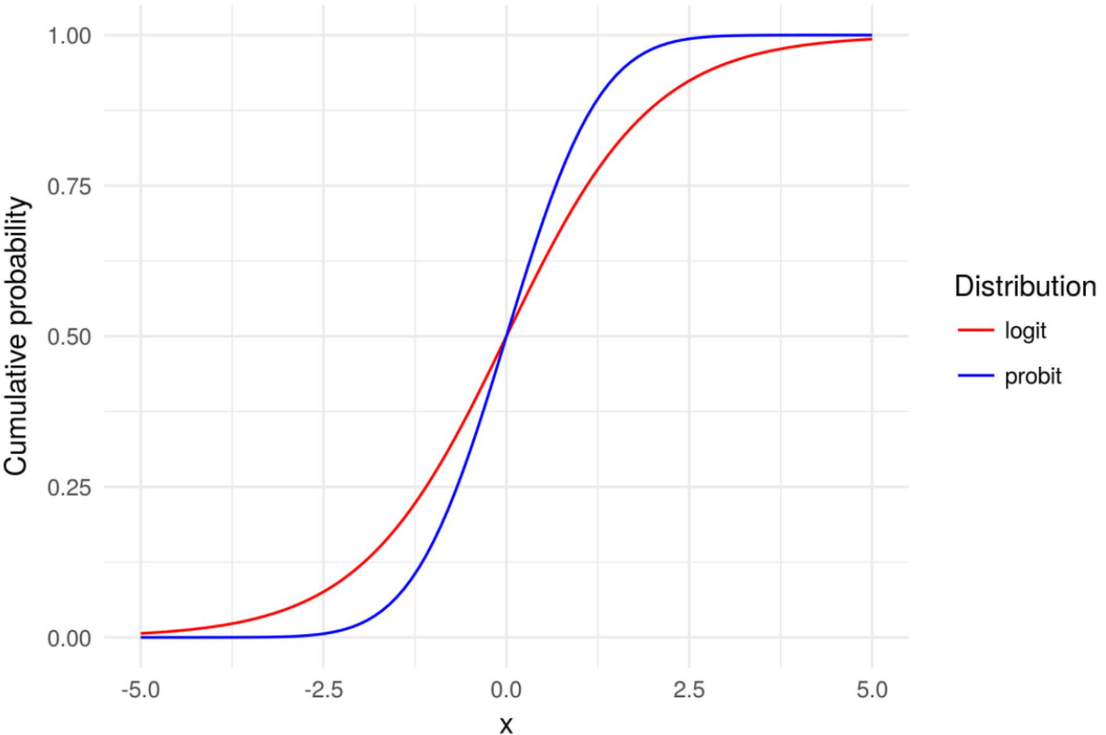
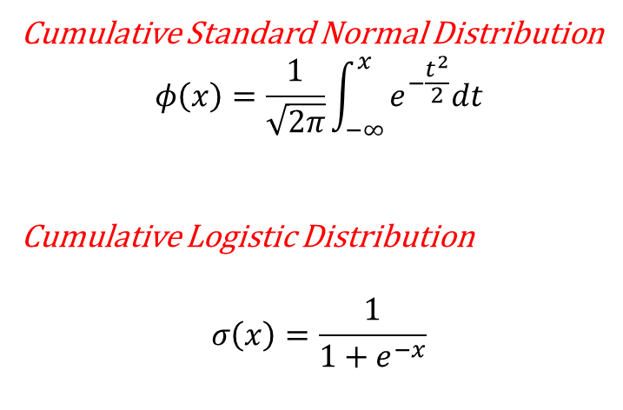
Probit vs. Logit - (Cont’d)
Cumulative Standard Normal Distribution
$$φ\left(x\right)=\frac{1}{\sqrt{2π}}\int_{−∞}^{x}{e^{−\frac{t^{2}}{2}}dt}$$
Cumulative Logistic Distribution
$$σ\left(x\right)=\frac{1}{1+e^{−x}}$$
Econometrics 2: Regression models for binary outcomes
University of Glasgow
2022-2023

Slide 7
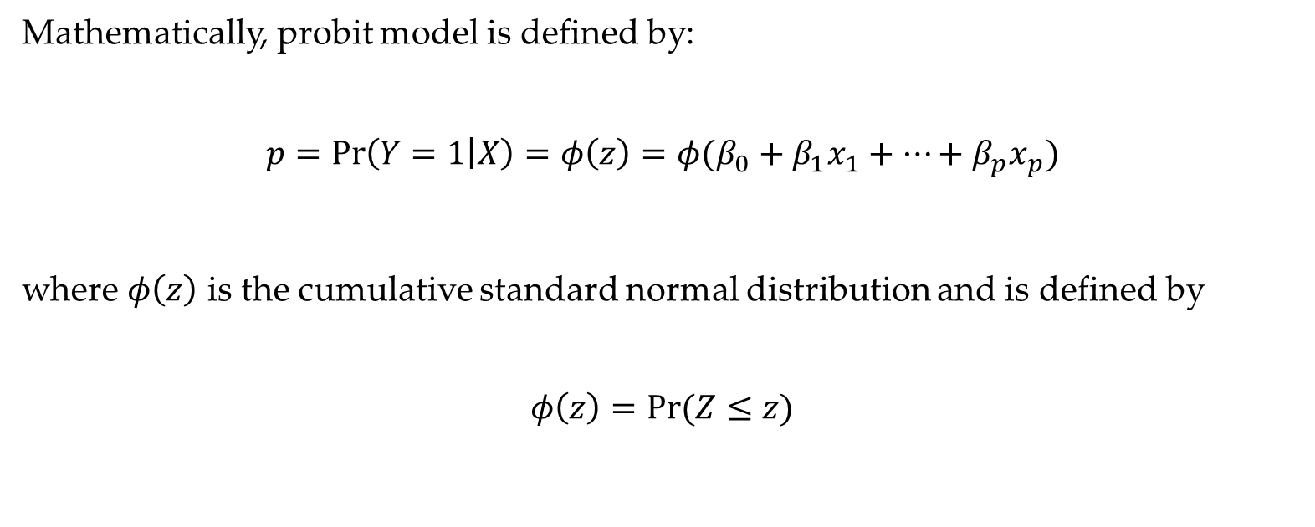
Probit Model
Mathematically, probit model is defined by:
$$p=\operatorname{Pr}\left(Y=1 | X\right)=φ\left(z\right)=φ(β_{0}+β_{1}x_{1}+…+β_{p}x_{p})$$
where $φ\left(z\right)$ is the cumulative standard normal distribution and is defined by
$$φ\left(z\right)=Pr(Z≤z)$$
Econometrics 2: Regression models for binary outcomes
University of Glasgow
2022-2023

Slide 8
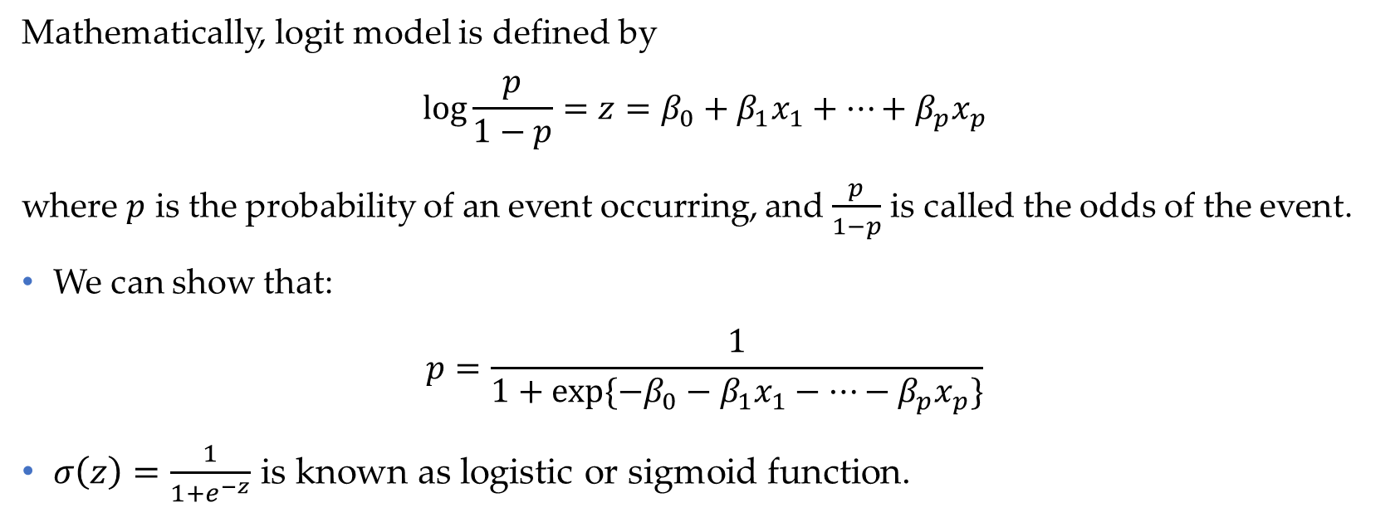
Logit Model
Mathematically, logit model is defined by
$$\log{\frac{p}{1−p}}=z=β_{0}+β_{1}x_{1}+…+β_{p}x_{p}$$
where $p$ is the probability of an event occurring, and $\frac{p}{1−p}$ is called the odds of the event.
We can show that:
$$p=\frac{1}{1+exp⁡\{−β_{0}−β_{1}x_{1}−…−β_{p}x_{p}\}}$$
$σ\left(z\right)=\frac{1}{1+e^{−z}}$ is known as logistic or sigmoid function.
Econometrics 2: Regression models for binary outcomes
University of Glasgow
2022-2023

Slide 9
Marginal effects
Marginal effect is the impact of variable of interest on the outcome variable while other variables are held constant.
In every linear model, like LPM, with linear effects the estimated coefficients are the same as marginal effects.
This result doesn't hold if we have non-linearities (e.g., interactions terms, power terms, etc.) in our model.
Unlike to LPM, marginal effects in probit and logit models are not very straightforward.
Econometrics 2: Regression models for binary outcomes
University of Glasgow
2022-2023

Slide 10
References
Horrace, W. C., & Oaxaca, R. L. (2006). Results on the bias and inconsistency of ordinary least squares for the linear probability model. Economics letters, 90(3), 321-327.
Wooldridge, J. M. (2013). A binary dependent variable: the linear probability model. Introductory econometrics: A modern approach, 5, 248-253.
Econometrics 2: Regression models for binary outcomes
University of Glasgow
2022-2023

